Slide 1
CIM
B11901027 王仁軒
PPT TemplateCredit : Jie-Hong Roland Jiang

Slide 2
Outline
Analog vs Digital
Analog CIM structure
Optimization techniques for analog designs
Digital CIM structure
Optimization techniques for digital designs
Optimization in other aspects

Slide 3
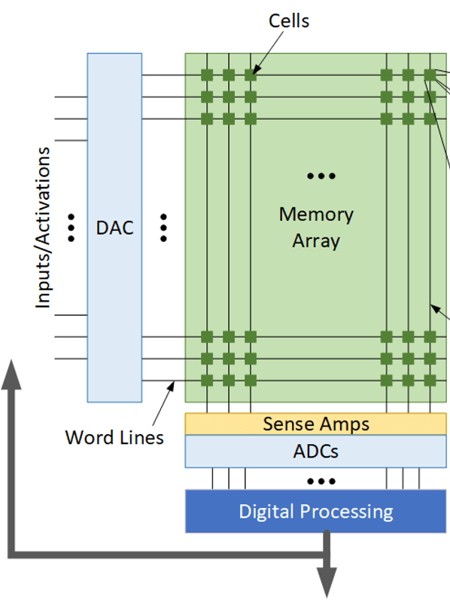
Analog CIM Structure
Typical analog CIM Structure
Require DAC & ADC
Multiply input with weight
(n-bit) (1-b)
Sum of all partial products

Slide 4
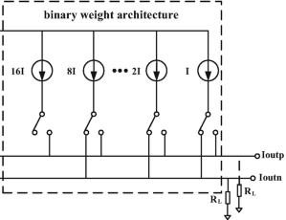
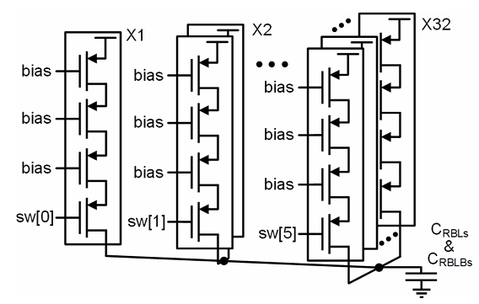

Optimization for Analog Designs
Analog multiplication requires DAC
Current source may consume lots of power
Not using DAC
Digital multiplication
Differential output
Current source are always on
Single-ended output
Can turn off current source
Require shift and sum
to do n-bit x n-bit
from 1-bit x 1-bit
Input_B
Weight(QB)
1-bit partial sum

Slide 5
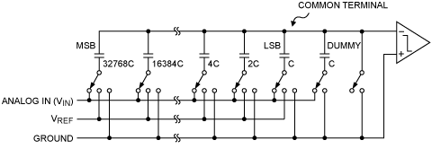
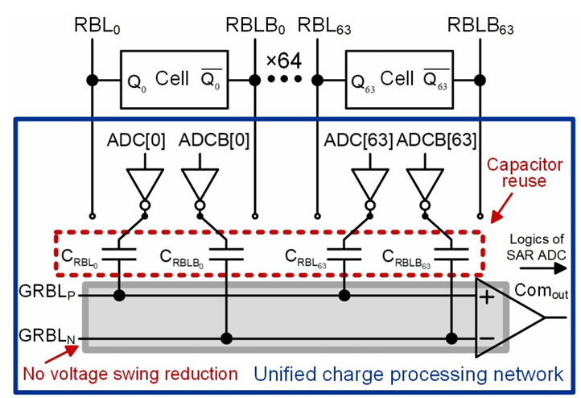
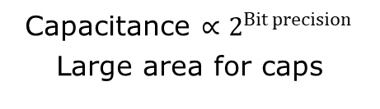
Optimization for Analog Designs
ADC is required
Reuse of Capacitors
Capacitance $∝2^{Bit precision}$
Large area for caps
Reuse of caps for ADC allows us to save area

Slide 6
Optimization for Analog Designs
Skipping iterations
Interleaving (memory cell)
Input has 32 1’s
Partial sum < 32
Skip first few iterations
saves time
sram
sram
RBL
RBL
sram
sram
sram
sram
sram
sram
RBL length = L
Parasitic caps = C
RBL length = L/2
Parasitic caps = C/2

Slide 7
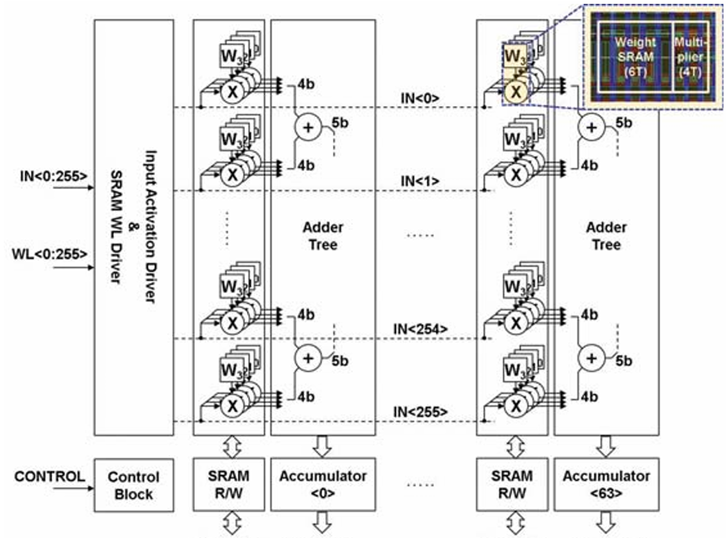
Digital CIM Structure
Typical digital CIM design
Serial input
Adder tree to sum
all partial sums
Digital multiplication
(1b input x 4b weight)

Slide 8
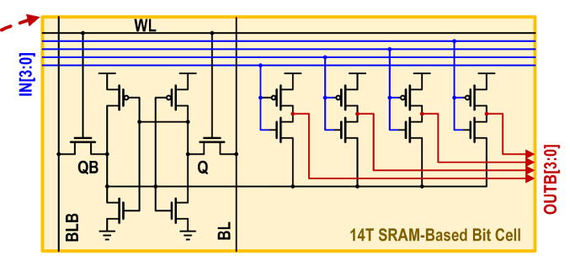
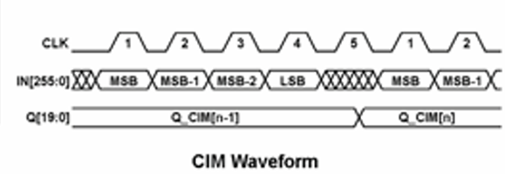
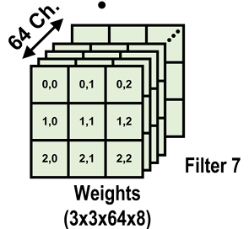
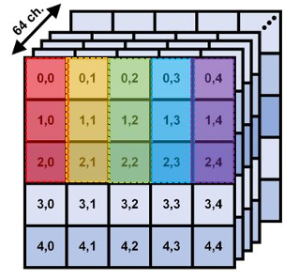
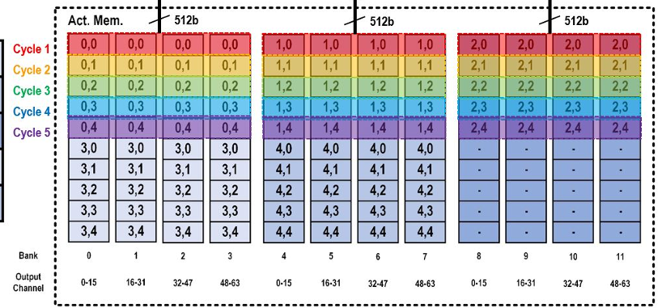
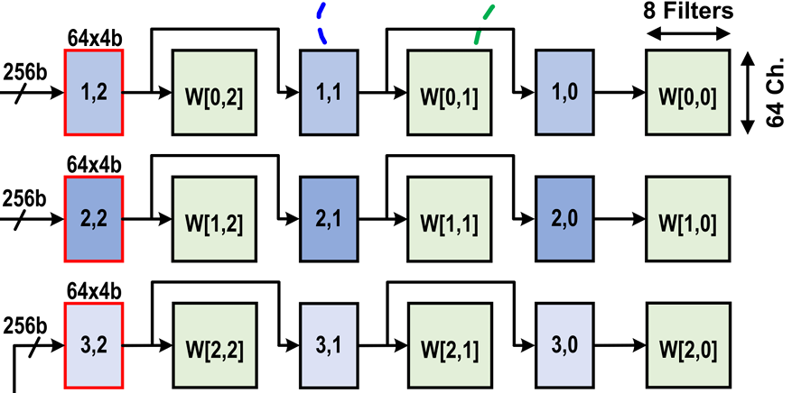
Optimization for Digital Designs
Increase throughput
Increase input BW
High BW input memory
In order to support MAC pipeline
Serial input
Require bit-precision+1 cycles
Parallel input
Require bit-precision/4+1 cycles

Slide 9
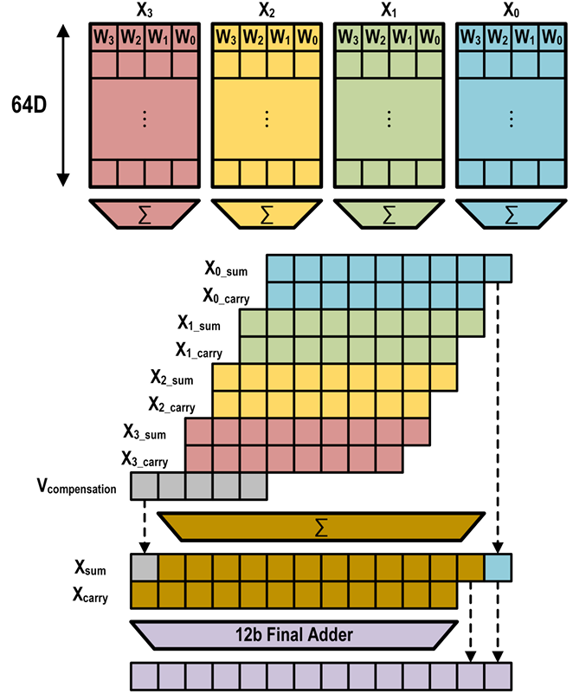
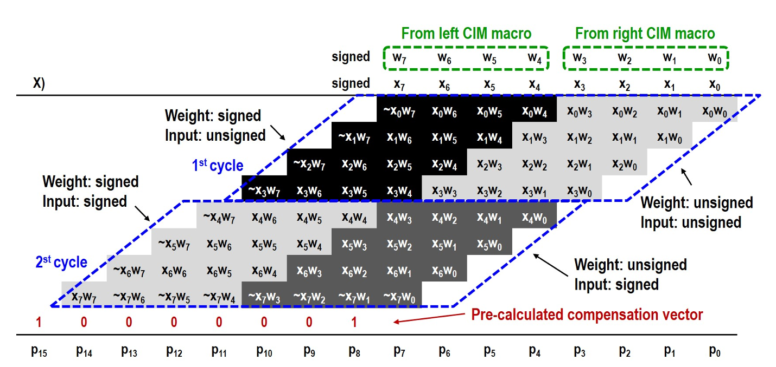
Optimization for Digital Designs
Bit-flexibility & Adder tree optimization
Each color is produced by a CIM block
Do not propagate carry
Faster than ripple-carry tree

Slide 10
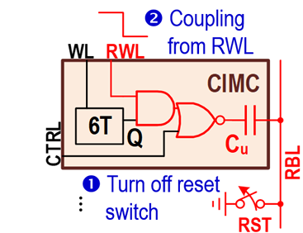
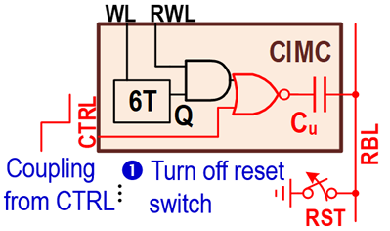
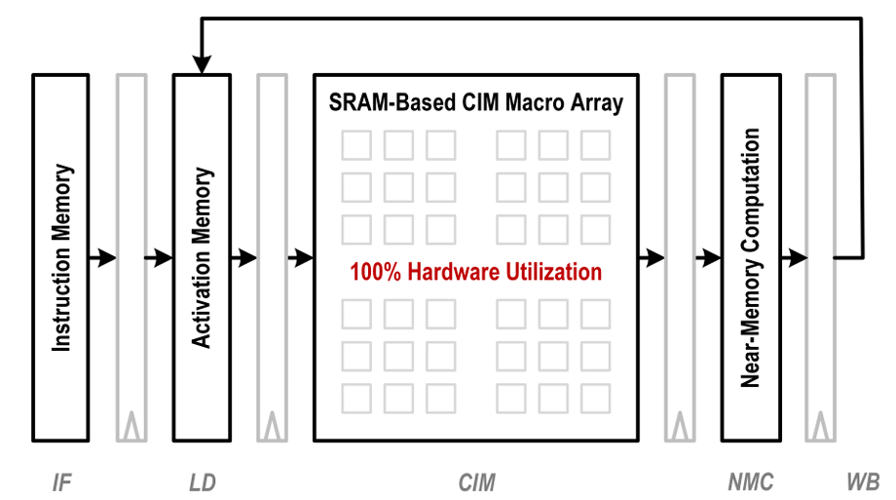
Optimization in Other Aspects
Simultaneous weight update & MAC
Pipelining
Increase throughput
SRAM is idle->
Update!
<-MAC

